Slide 1
Welcome Ángel
Project Ideas

Slide 2
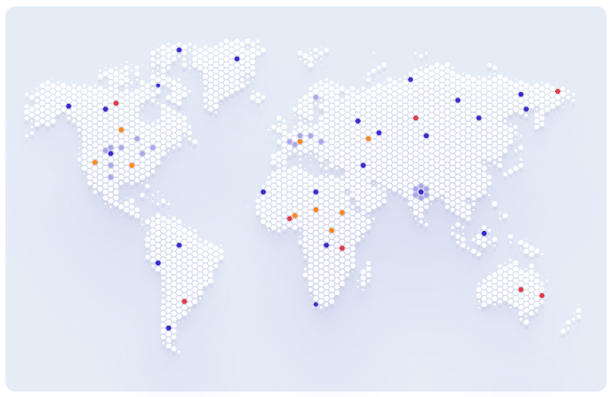
1. Failures Map
Implement an interactive map that shows where failures occur.
Use dots or hexagons that change colour based on the number of failures.
Consider a version where the map can be zoomed in if, for example, all the failures are in Europe.

Slide 3
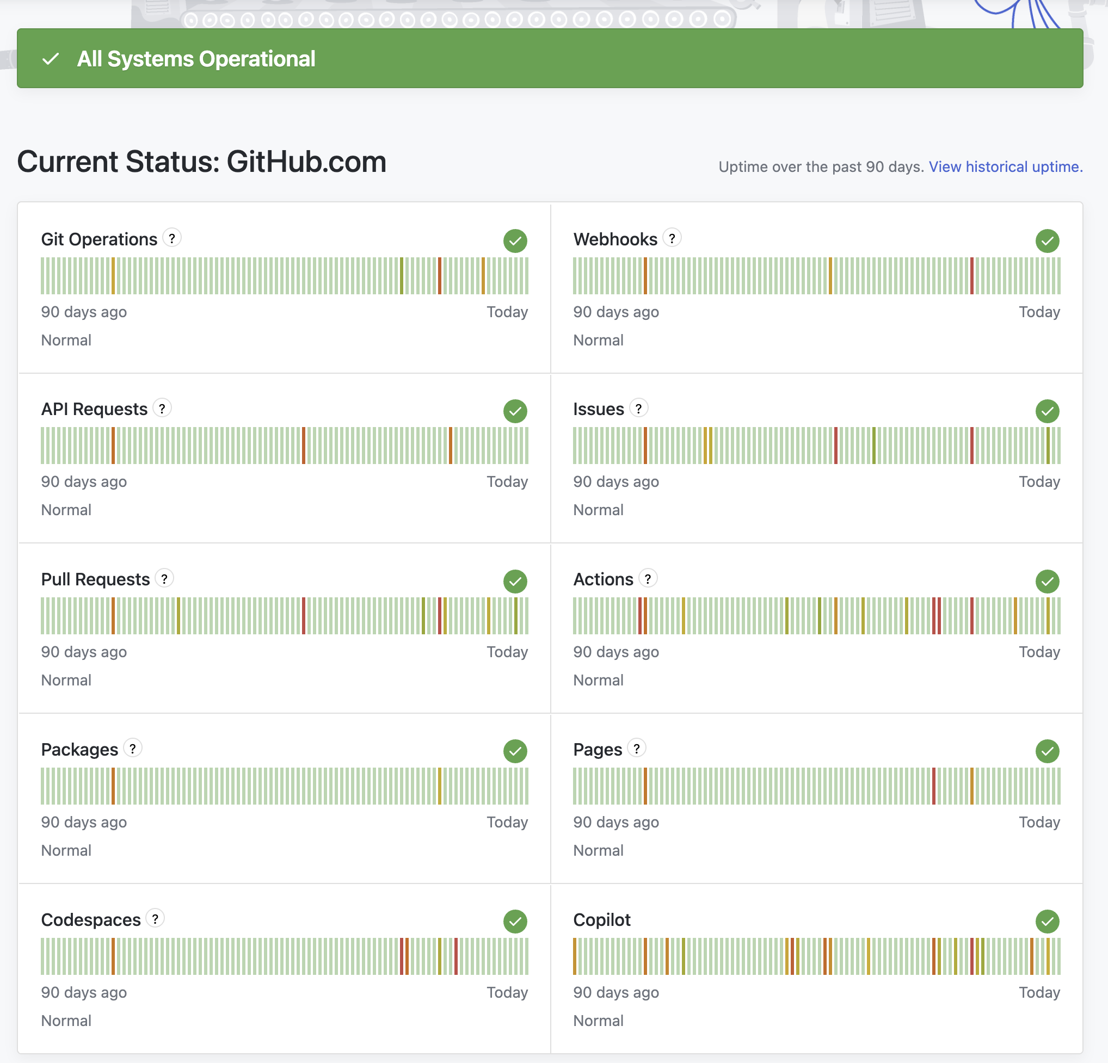
2. Status Page
An online page that shows the status of our platforms, APIs, or services in general.
Think of the status page of GitHub or other popular online services that tell you whether a service is down or everything is running as it should.

Slide 4
3. Pick And Place AI Analyser
An AI analyser that checks that all the components in the BOM are coded in the P&P file and that, in the P&P file, there are no components listed as “do not mount.”
The BOM (Bill of Materials) is a list of all the components needed to assemble the board.
The Pick and Place file is a file that contains the code for the robot to pick the components and place them at the correct coordinates on the board.

Slide 5
4. AI Helper/Chatbot
Create an AI-powered chatbot/helper for users.
Users can use this tool to find out what to do in specific situations or to ask questions about anything that is not clear.

Slide 6
5. Modern FAQ Page
Create a modern FAQ page for customers.
This page may or may not use AI.
It should not be a simple list of frequently asked questions, but a modern page where users can also find materials, documentation, contacts, forms, and more.

Slide 7
6. AI Component Analyser
Create an AI analyser that checks component attributes and specifications.
Components that need to be soldered on the board can be divided into two main groups: THT and SMT.
The type of component is determined from its specifications, but sometimes this automatic tool is uncertain about the result.
The tool should detect when this attribute is missing, search for the component specifications, and fill in the field.

Slide 8
7. AI Component Alternative Finder
An AI analyser that searches for alternative components when the ones chosen by the customer are not available.
This tool should run in the background and propose compatible components to the customer, but only if there is no match with the providers we currently have.

Slide 9
8. Improve Observability
Improve our observability capabilities to trace errors more comprehensively.
We currently use Grafana Cloud, which has some limitations, so we want to self-host Grafana on a VM or dedicated machine.
The steps are:
Install Grafana in a local environment.
Import all dashboards and queries already implemented in the cloud.
Change the configuration of our containers to point to the new Grafana instance.
Consider changing and adding new queries and dashboards.

Slide 10
9. Team Week Planner
Create a platform where team members can add their leave days, to see any overlap between colleagues.
Users should be able to add all the days when they plan to work from home.
They should also be able to inform their team which company site they will be at, in case they are not working from the usual office.
Ideally, there should be a notification system that reminds you to fill in your weekly data, so nobody forgets. You should also be able to see the weekly plan displayed as a calendar or similar view.

